Slide 1
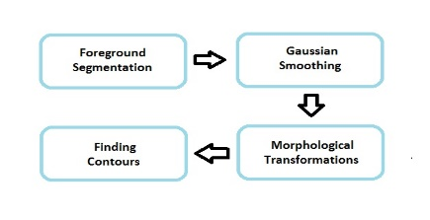
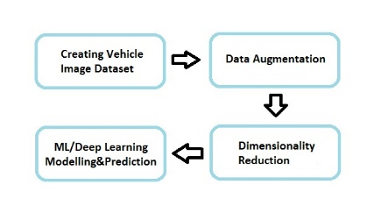
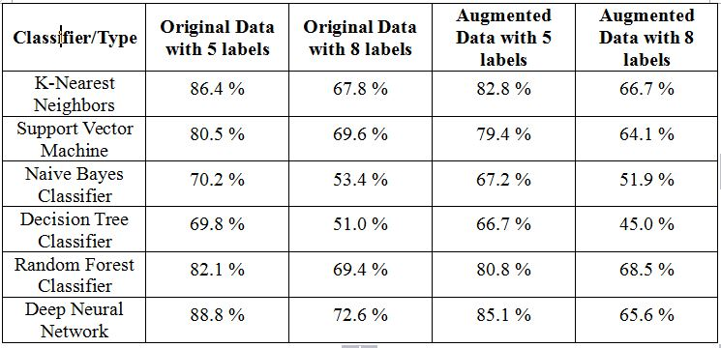
Vehicle Classification to Event Detection
Osman Furkan KINLI
Problem Statement
(Theoretical) Background
How to detect and classify vehicles on the highway?
WHY?
Gather traffic statistics
  Achieve better traffic control
  Problem as high/low intraclass variation
Foreground Segmentation
Gaussian Smoothing
Morphological Transformations
Finding Contours
Creating Vehicle Image Dataset
Data Augmentation
Principle Component Analysis
Machine Learning Algorithms
Deep Learning
Overall Approach/Design
Implementation Issues
Detection
Classifying
  Challenges:
  Labeling each image one by one
  Deciding the parameters on ML models
  Training time for Deep Learning Model
  Employed Tools, Techniques, Standards:
  Implementation with C++ & Python
  MS Visual Studio 15 & JetBrains PyCharm
  OpenCV
  Tensorflow
Validation
Results
Experimental Setup:
  Labelling 2.500 images
  Augmenting data to 10.000 images
  Training set: 7.500 images
  Test set: 2.500 images
Evaluation Metrics:
  Confusion Matrix
Accuracy Rates:
Limitations:
  Camera Stabilization
  Standing Vehicle Detection
  Undefined Types of Vehicles
  Computational Power

